Slide 1
For Your Safety and Protection Safe Environment Ninth Grade

Slide 2
God loves you more than any other person loves you.
Notes:
Take a moment to think about how you know this to be true. Discuss.

Slide 3
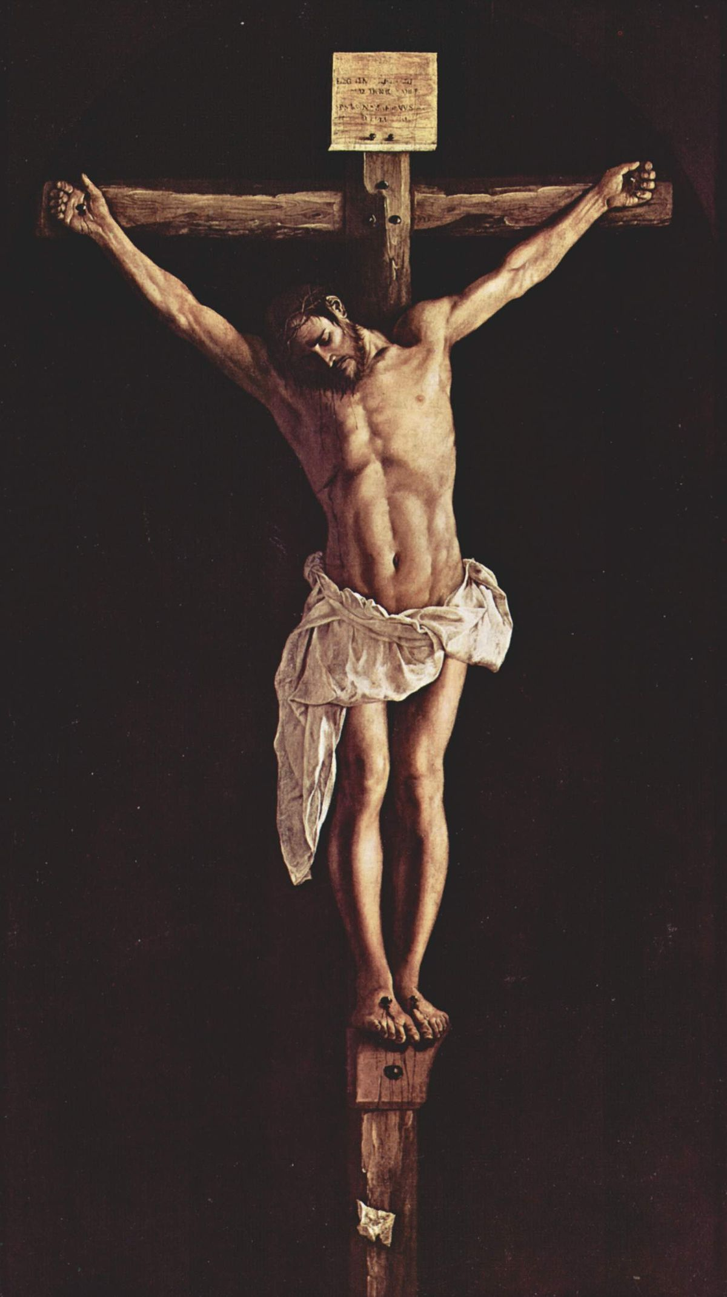
Jesus knows you personally
and gave everything for you.
Notes:
Jesus understands pain, fear and suffering because, as the second Person of the Holy Trinity, He experienced them, and He wants to support and strengthen you by His love when you are lonely, uncertain or anxious. Jesus gave everything for you! When you look at the Cross, Jesus’ open arms invite you to receive that love by opening your heart to Him in prayer and through the Sacraments.

Slide 4
“Jesus I trust in you.”
Notes:
You can trust Jesus. He has given everything so that you can know the difference between His will and the will of the devil – the father of lies, selfishness, sin, and death. A great saint of the last century, St Faustina, taught us this simple but powerful prayer: “Jesus, I trust in you.”

Slide 5
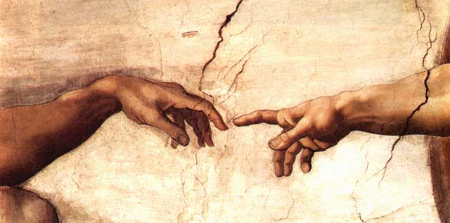
God created you in His image and likeness.
Notes:
God created you in His image and likeness. That means that you are a beloved son or daughter of God. He dwells within you. When “the Word became flesh,” God Himself took human form and so made you holy. That means that your body and soul are precious in the eyes of God. When you reflect carefully about this great truth, you can better decide how to make important choices, for yourself and for others, so that you will always act in a way pleasing to God. To strive to please God in all things will not necessarily make for an easy life—Jesus told His disciples that we must carry the Cross after Him—but it will make for a fulfilled and happy life, because He promised this.

Slide 6
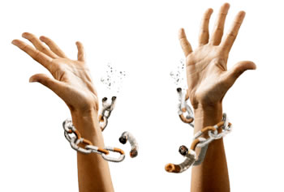
“I no longer call you slaves but I call you friends.” - Jesus
Notes:
“I no longer call you slaves but I call you friends.” - Jesus
The greatest friendship you can have is with Jesus. You and I can be friends of the Lord because He greatly desires it. At the Last Supper, just before giving the gift of His own Body and Blood in the Eucharist and before dying to redeem each and every person on the Cross, Jesus said, “I no longer call you slaves, …I call you friends” (John 15:15).
Jesus was speaking of the total transformation that He was bringing about for the whole human family through the total gift of Himself on the Cross. Until Jesus gave His life for you in the Eucharist and on the Cross, we were not redeemed, we were not released from the slavery of sin. The chains of selfishness and sin were not broken and the gates of hell were not destroyed until Jesus laid down His life for us. Every human person could rightly be called “slaves” before the Passion of Christ. What a great blessing that Jesus is able, and greatly desires, to call us not slaves but His friends. And what a blessing that He keeps freeing us through His mercy from the bondage of sin, breaking the chains of our addictions and the bad habits that enslave us. Jesus came to set captives free, so that you could become His friend. This is the heart of the Good News of Christ.
Choose to avoid and break a bad habit by cooperating with the power of God’s grace through daily prayer and receiving the Sacraments.

Slide 7
Jesus tells us what true friendship is:
“No one has greater love than this, to lay down one’s life for
one’s friends.”
Notes:
Jesus layed His life down for you, and for every other person. This is the friendship above all others. This helps us to understand why the Eucharist is the greatest treasure of the Church, and why receiving Christ in Holy Communion is the greatest of all blessings. Jesus is offering the gift of Himself, the gift of intimate friendship. We are to imitate Jesus in respecting others by seeking their good. How? Strive to lay down any selfishness in your life, and treat every person with respect.
What are the different ways you can lay down your life for a friend? Laying down your life does not necessarily mean being put to death for someone, but it means respecting and seeking the good of the other person.
Examples:
It could be sticking up for someone being bullied
completely forgiving someone who has wronged you.
What are other ways to lay your life down for another person?

Slide 8
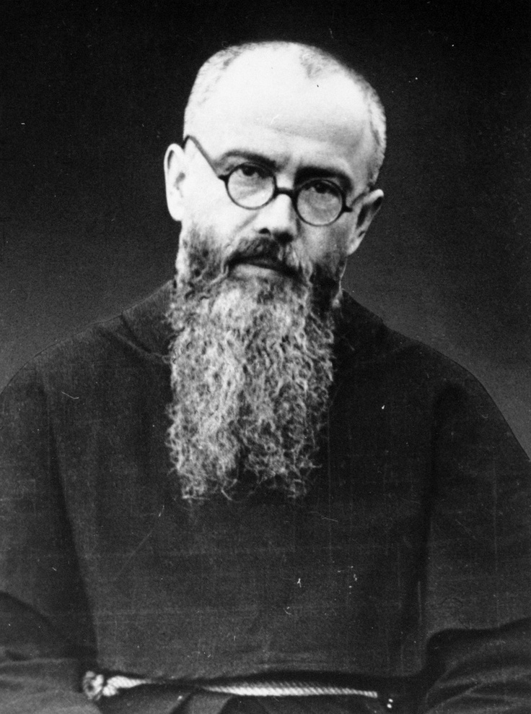
Saint Maximilian Kolbe is a perfect example of what Jesus meant when He said, “No one has greater love than this, to lay down one’s life for one’s friends.”
Notes:
Look at Saint Maximilian Kolbe. “In July of 1941, it was reported to the deputy camp commander that a prisoner from St. Maximilian’s barracks had escaped. In order to set an example, and to prevent further escapes, the standard procedure was to have the commander of the barracks single out ten men for the starvation bunker. Father Maximilian, although not among the ten first selected, volunteered, in a heroic act of charity, to be the victim in place of a prisoner who cried out: ‘My poor wife; my poor children!’ The result of this self-offering was that Father Maximilian would be assigned to the infamous starvation bunker where he would slowly but surely die.” (saintmaximiliankolbe.com/biography)

Slide 9
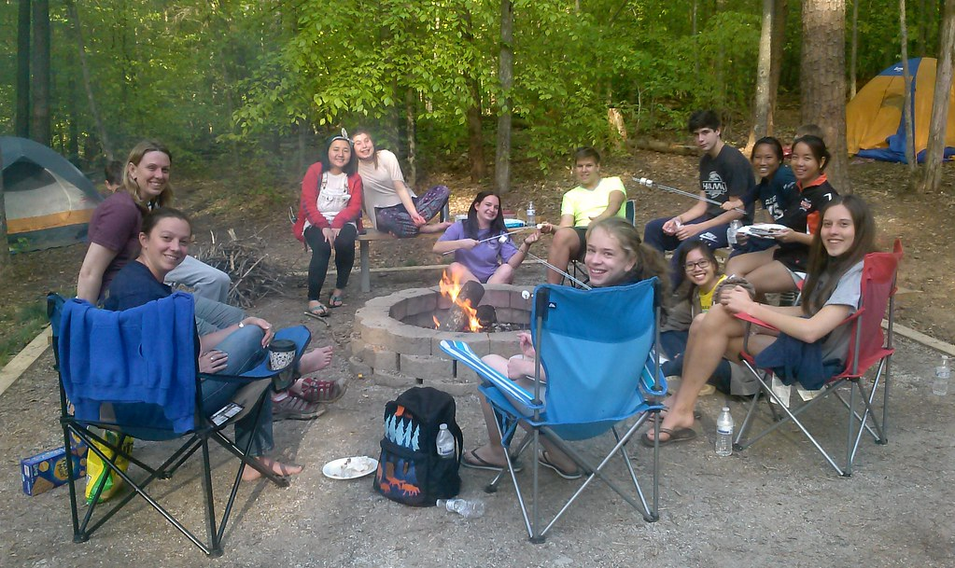
True friendship means that we have to love our friends enough to lead them away from paths that separate them from God.
Notes:
“Love one another as I have loved you.” - Jesus
We would not have any good friends without making choices for their good and choosing to make a gift of ourselves to them in love. And yet, a true friend is far more a gift of God than an achievement of ours.
We have freedom to accept or reject whomever the Lord gives us to love. When we live by the “golden rule”, doing to others what we would have them do to us – treating each person with respect, compassion and authentic love – we manifest the love of the Father, completing what He has done for us.
True friendship means that we love our friends enough, and for them to love you enough, to lead each other away from paths that separate you and them from God. True friendship means saying no to sin for the good of ourselves and the other person. Our SECULAR culture says that to love someone, we must accept everything they do. But true love is loving others enough to steer them from the things that could harm them and accompanying them on the path to discover who they truly are as a child of God.
How do you cooperate with the power of God’s grace, received in prayer and the Sacraments, to forgive another person when they offend you?

Slide 10
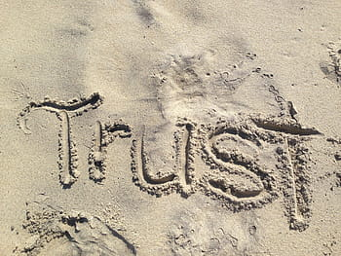
God is good and only wants what is best for you.
Notes:
God is good and only wants what is best for you.
In your daily life, you need to play your part by seeking to protect yourself from sinful behaviors with their damaging effects, as well as by guarding against situations that are dangerous and people who may cause you harm. God has given you a Guardian Angel who is always with you, seeking to guard and guide you. Pray the Guardian Angel prayer each day to remind you of this.
Remember that believing and trusting in God does not mean you won’t go through suffering, but it means that you have an ally who walks with you through the suffering. You are never alone. Perhaps the best thing to remember is that God understands suffering first hand. Look at Jesus Christ, the second person of the Holy Trinity. He was fully God and fully man, and in the Gospels we read about how He suffered in the last days of His life: physically, emotionally, spiritually, and psychologically. He suffered every way a human being can suffer. So when you are suffering remember, when you pray, that God has been there, He understands, and He is present. Trust in the presence, love, grace, and mercy of our Lord.

Slide 11
The following are practical steps to avoid potential danger:
Notes:
The following are practical steps to avoid potential danger.
Avoiding potential danger means being careful to avoid certain situations, and praying for the courage to speak up to friends to help avoid situations that could make you and them vulnerable to harm.

Slide 12
Talk to your parents! Say more than “Hi” and “Bye.”
Notes:
Talk to your parents.
Say more than “Hi” and “Bye.” Let them know what is going on in your life. Talk about the difficulties, struggles, worries, and also what you’re excited about and what is going well. Opening up to your parents, even a little will mean the world to them. The more you improve your communication with them, the stronger your relationship will be. Let them be part of your life by letting them know where you are at all times, who you are with, etc. Also, make sure your parents are aware of any meetings or correspondence (email, etc.) with an adult, school counselor, priest, youth minister, etc.

Slide 13
Ask questions, think ahead, and use good judgement.
Notes:
Ask questions, think ahead and use good judgment.
Pray for the strength to say no to plans that could be unsafe. Take time for silence so that you can learn to recognize the inner promptings of the Holy Spirit, who will guide you on the right path.
Asking questions is not a sign of weakness, but a sign of strength that you are thinking. Remember that sometimes in situations that are unsafe, or just not a good idea, that there is probably someone or several people waiting for someone else to speak up and say, “This is not a good idea.” Be brave, and don’t be afraid to be a leader and take a stand.

Slide 14
Always be aware of your surroundings, and avoid people or situations that could lead you down the wrong path.
Notes:
Always be aware of your surroundings, and trust your instinct that a situation could be dangerous.
Sacred Scripture, the very Word of God, lights our path to what is good, true and beautiful – to what brings peace, joy and fulfillment. Read the Word of God in Sacred Scripture a few minutes each day, beginning with the New Testament. Pray for the grace to be obedient to where the good God is leading you.

Slide 15
Notes:
Guard against relationships that involve deception, manipulation, intimidation or exploitation.
Relationships are important, but the key to a good relationship is how we treat each other. Sometimes people who are misguided see a relationship the same way they see a possession. A good relationship requires mutual respect and love for the God-given dignity of ourselves and the other person. People are to never be treated as objects or possessions. If you are being treated as an object or a possession, then you should tell a trusted adult and completely break free from that relationship.
Do not use another person or allow yourself to be used. Respect the rights, dignity and worth of each person.
Using another person can be in a physical form and/or psychological form. Sometimes people allow themselves to be used because they want to be liked. But true friendship can never include using another person.

Slide 16
Notes:
Refrain from using foul language and from sexually offensive humor in conversations. “Consider what a great forest is set on fire by a small spark. The tongue also is a fire…” No human being can tame the tongue. It is a restless evil, full of deadly poison. With the tongue we praise our Lord and Father, and with it we curse human beings, who have been made in God’s likeness. Out of the same mouth come praise and cursing. My brothers and sisters, this should not be. (by analogy) Can both fresh water and salt water flow from the same spring?” (James 3:5-6, 8-11)
Your words have meaning. They can be used to love others and build people up, or they can be used to cut people down. Your words can be used to bring the Gospel message to people, or they can be used to cause people to stray from God in their thoughts and in their words. The way you speak is contagious. When you speak, others are likely to feed off of you and be an echo of your words. So, we have to ask ourselves, “Is the source of your words charity, or selfishness?”

Slide 17
You are a person to be loved, not a body to be used.
Notes:
The way we dress is important. It is how we present ourselves. Wear clothing that does not draw specific attention to one part of your body. You are a person to be loved, not a body to be used. Therefore, you will want to dress modestly.
“Modesty is more than just a hemline, it is an interior disposition that influences not only our dress, but our thoughts and actions.” Leah Darrow (pictured) That interior disposition is: Live with respect for yourself and the assurance that you are a son or daughter of God.
How do you present yourself as a child of God? What is it about you that helps people instantly recognize that you are a child of God?

Slide 18
Use the “2 by 2” principle, always be with a friend who you can depend on.
Notes:
Use the “2 by 2” principle: Having a trusted friend you know you can depend on.
Use the “2 by 2” principle – when with an adult or out with people your own age, always be with a trusted friend with whom you can depend on. Commit to looking out for one another’s well-being, always knowing where the other person is. Always go places in groups.

Slide 19
Notes:
Avoid numbing your conscience with drugs and alcohol.
Avoid drugs and alcohol. When people are intoxicated, they are completely unsafe, physically and spiritually, because their consciences are numbed and they are unable to make good decisions. Avoid others who are intoxicated. Even people you know well cannot be trusted in that state.

Slide 20
Stay away someone who has abused another person
Notes:
If you know of someone who has abused another person, they should not be near you.
Many times someone who has abused another person before will do it again. They tend to see people as objects and/or possessions. They truly need professional help to understand other peoples’ dignity and worth.

Slide 21
Communicate your concerns
Notes:
Communicate your concerns
Communicating your concerns means telling someone in authority when you are uncomfortable with a situation or a person, and most especially if you have been abused or you suspect that someone else may have been abused. Pay attention to your own intuitions/feelings. Even if abuse is not occurring, it is still important to let others know when you have concerns. Remember the following:

Slide 22
Be a true friend even at the risk of upsetting him/her by “overreacting”.
Notes:
Communicate your concerns
Be a true friend even at the risk of upsetting him/her by “overreacting”. If you are worried that a friend is being/has been abused, tell someone in authority. If you have sought help from someone in authority and that person does not take action, tell another person in authority.

Slide 23
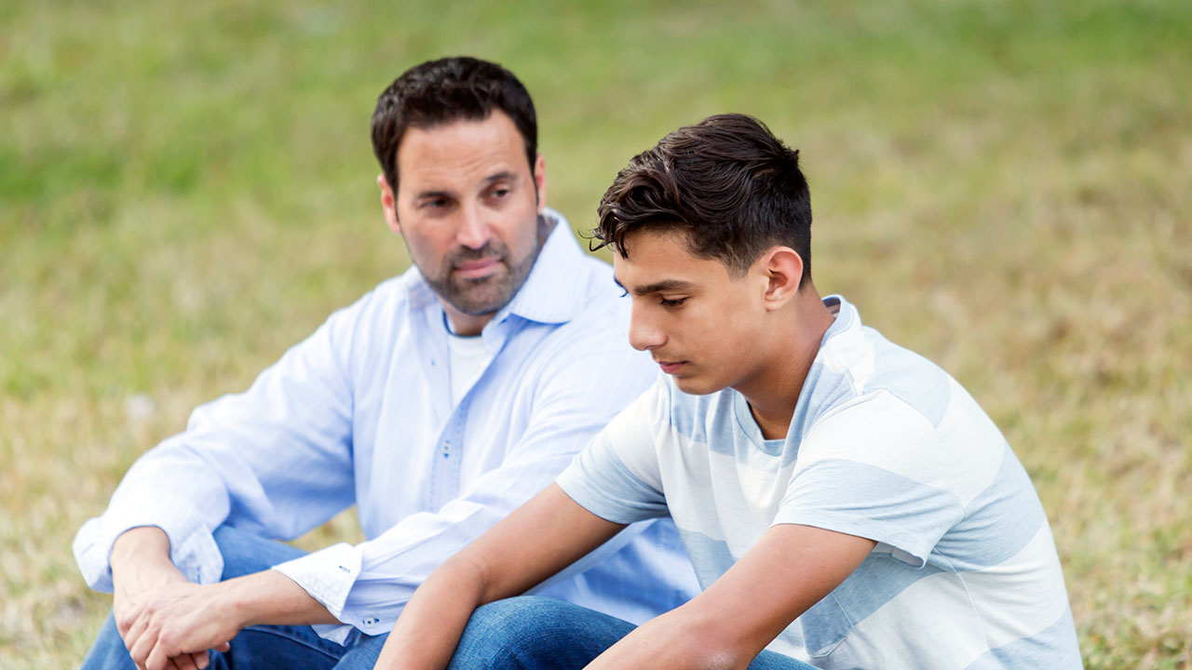
If you have been abused, speak with a trusted adult about it.
Notes:
Communicate your concerns
If you have been abused, it is not your fault, even if you have not followed the steps listed above to avoiding potential danger. Do not fear being blamed. You will not be. Speak with a trusted adult about it. DO NOT KEEP IT A SECRET. Jesus said, “The truth will set you free.”

Slide 24
Pay attention to your own intuitions/feelings.
Notes:
Communicate your concerns
Communicating your concerns means telling someone in authority when you are uncomfortable with a situation or a person, and most especially if you have been abused or you suspect that someone else may have been abused. Pay attention to your own intuitions/feelings. Even if abuse is not occurring, it is still important to let others know when you have concerns. Remember the following:
There is a network of help at home, in friends, at school, in the Church, and in various other organizations. There is always someone to turn to in every situation. Specifically:
Always talk to your parents about your concerns.
Notify a church official, principal and/or
Do not hesitate to call the police.
If you or someone you know has a tendency to sexually destructive behavior – contact someone in authority (anyone mentioned above) for help before you or someone else gets hurt. There is no shortage of help for those who seek it.

Slide 25
Notes:
Know the warning signs of a potential predator:
Always wants to be alone with young people.
Gives gifts to young people often without permission.
Goes overboard touching. Is not respectful of a young person’s comfort zone.
Thinks the rules do not apply to them.
Allows young people to engage in activities their parents would not allow.
Uses bad language or tells dirty jokes to young people.
Shows young people pornography
Don’t be fooled, realize that most molesters:
Look like everyone else.
Are often in a trusted role with young people
Sometimes use their church association to gain trust.
Can be very patient while they plan the abuse.

Slide 26
Remember
God loves you very much!
You have incredible worth as a child of God.
You, and every person, are to be treated with respect.

Slide 27
If you are being harmed, or if you feel sad, scared, unsafe, or uncomfortable, then tell an adult that you trust right away!
Notes:
Discuss your safety plans with your parents and ask for their guidance when you are planning an outing. “What should I do if…” Always tell your parents where you are going, with whom you are going, and the time that you will return so that they can find you if needed.

Slide 28
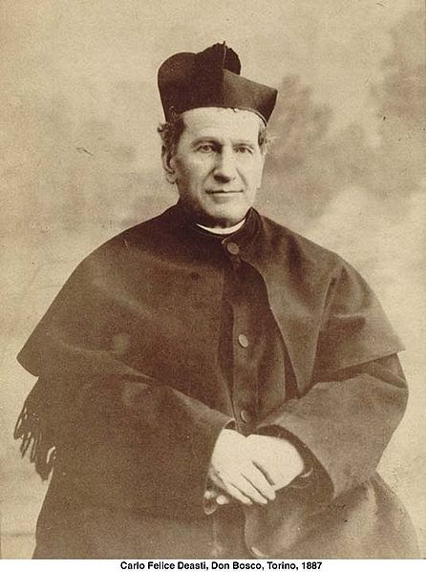
O Saint John Bosco, father and teacher of youth, you labored so much for the salvation of souls.
Help us to respect ourselves and each person as a child of God. Be our guide in seeking the good of our souls and the salvation of our neighbor.
Teach us to love Jesus in the Blessed Sacrament, Mary the Mother of Christ and our Mother, and our Holy Father the Pope.
Obtain for us from God the grace to one day be gathered all together with you in Heaven. Amen.
Notes:
The prayer to St. John Bosco, the patron of youth, in the virtue of respect, Diocesan Virtue Program, page 3. diolc.org/catechesis/understanding-and-living-the-virtues/respect.
Make a copy for each student:
O Saint John Bosco, father and teacher of youth, you labored so much for the salvation of souls.
Help us to respect ourselves and each person as a child of God. Be our guide in seeking the good of our souls and the salvation of our neighbor.
Teach us to love Jesus in the Blessed Sacrament, Mary the Mother of Christ and our Mother, and our Holy Father the Pope. Obtain for us from God the grace to one day be gathered all together with you in Heaven. Amen.

